Slide 1
IT5302 SOFTWARE ENGINEERING

Slide 2
Requirements Modeling Strategies
One view of requirements modeling, called Structured analysis, considers data and the processes that transform the data as separate entities.
Data objects are modeled in a way that defines their attributes and relationships.
Process that manipulate data objects are modeled in a manner that shows how they transform data as data objects flow through the system.
A second approach to analysis modeling, called Object-Oriented analysis, focuses on the definition of classes and the manner in which they collaborate with one another to effect customer requirements.

Slide 3
Flow Oriented Modeling
Data Flow diagram (DFD) takes an input-process-output view of a system.
Data objects flow into the software are transformed by processing elements and resultant data objects flow out of the software.
Data objects are represented by labeled arrows and transformations are represented by circles ( bubbles).
DFD is represented in hierarchical fashion.
The first data flow model (a level 0 DFD or context diagram) represents the system as a whole.

Slide 4
Creating a Data Flow Model
A few simple guidelines can aid immeasurably during the derivation of a data flow diagram:
The level 0 data flow diagram should depict the software/system as a single bubble.
Primary input and output should be carefully noted.
Refinement should begin by isolating candidate processes, data objects and data stores to be represented at the next level.
All arrows and bubbles should be labeled with meaningful names.
Information flow continuity must be maintained from level to level.
One bubble at a time should be refined.

Slide 5
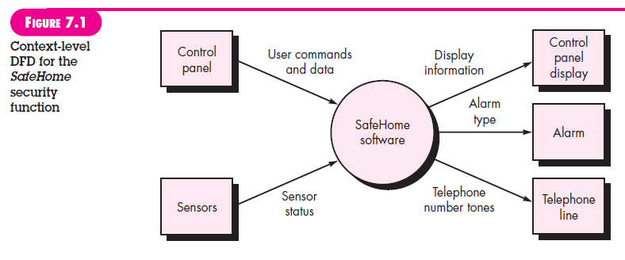
Consider the SafeHome security function. A level 0 DFD for the security function is shown in figure.
A primary external entities (boxes ) produce information for use by the system and consume information gathered by the system.
The labeled arrows represent data objects or data object hierarchies.

Slide 6
By performing a grammatical parse on the processing narrative for a bubble at any DFD level, you can generate much useful information about how to proceed with the refinement to the next level.
The processes represented at DFD level 1 can be further refined into lower levels.
The refinement of DFDs continues until each bubble performs a simple function.
That is, until the process represented by the bubble performs a function that would be easily implemented as a program component.

Slide 7
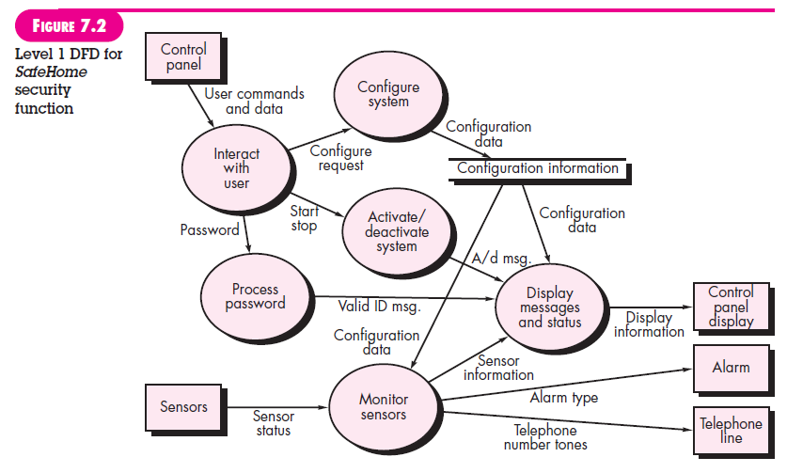

Slide 8
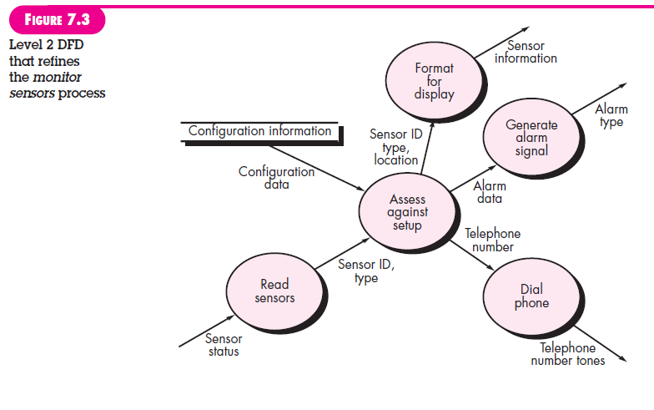

Slide 9
Creating a Control Flow Model
For some types of applications, the data model and the data flow diagram are all that is necessary to obtain meaningful insight into software requirements.
A large class of applications are ‘driven’ by events rather than data, produce control information rather than reports or displays and process information with heavy concern for time and performance.
Such applications require the use of control flow modeling in addition to data flow modeling.
An event or control item is implemented as a Boolean value (e.g., True or False, On or Off) or a discrete list of conditions (e.g., empty, jammed, full).

Slide 10
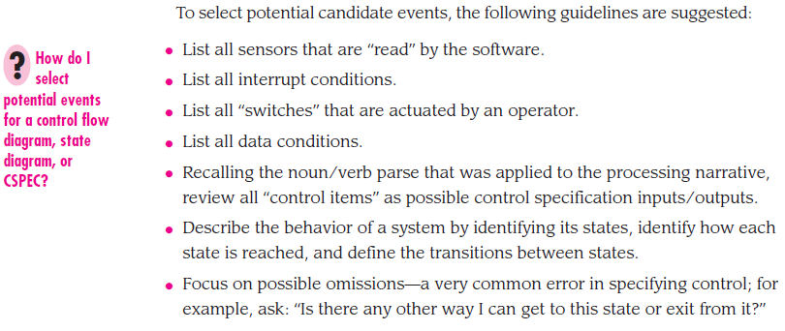
Example: SafeHome security

Slide 11
The control specification
A control specification (CSPEC) represents the behavior of the system.
CSPEC contains a state diagram that is a sequential specification of behavior.
It can also contain a program activation table- a combinatorial specification of behavior.
By reviewing the state diagram, you can determine the behavior of the system and more important, as certain whether there are ‘holes’ in the specified behavior.

Slide 12
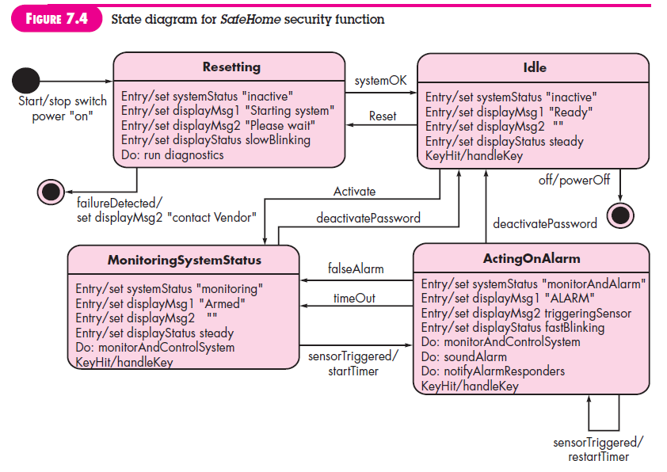

Slide 13
A somewhat different mode of behavioral representation is the Process Activation Table (PAT).
PAT represents information contained in the state diagram in the context of processes, not states.
The table indicates which process(bubbles) in the flow model will be invoked when an event occurs
PAT can be used as a guide for a designer who must build an executive that controls the processes represented at this level.

Slide 14
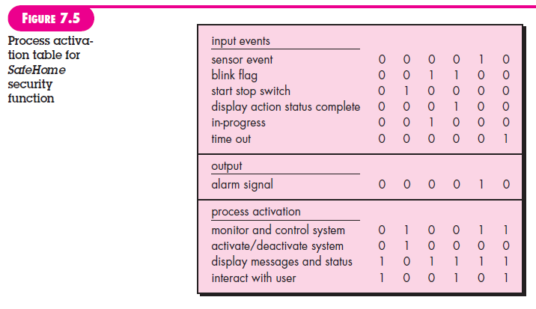
A PAT for the level 1 flow model of SafeHome is shown in figure.

Slide 15
The Process Specification
The process specification (PSPEC) is used to describe all flow model processes that appear at the final level of refinement.
The context of the process specification can include narrative text, a program design language (PDL) description of the process algorithm, mathematical equations, tables or UML activity diagrams.

Slide 16
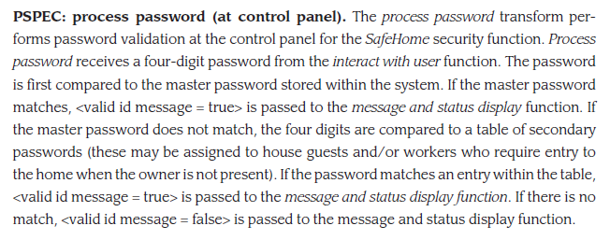
Consider the process password transform represented in the flow model for SafeHome (Fig 7.2). The PSPEC for this function might take the form:

